Slide 1



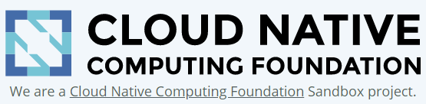
GitOps & SLO-Driven Automation driving faster and better releases!
Andreas Grabner
DevOps Activist at Dynatrace
DevRel for Keptn
@grabnerandi, https://www.linkedin.com/in/grabnerandi
Follow us @keptnProject
Star us @ https://github.com/keptn/keptn
Slack Us @ https://slack.keptn.sh

Slide 2


Slide 3
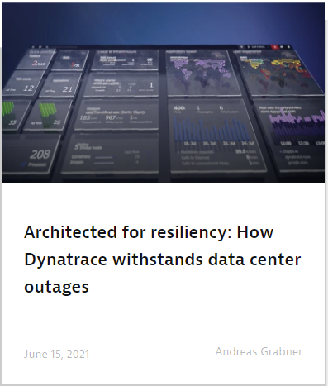
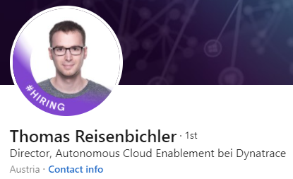
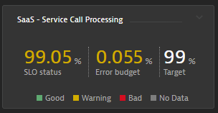
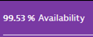
4 hour AWS EC2 Outage: ZERO Impact for Dynatrace
“Observing this issue, it was an honor to have the possibility to ‘just’ sit next to it and do a little bit of babysitting knowing that we are coping very well with this failure!”
Service Level Objectives
Service Level Agreements
https://www.dynatrace.com/news/blog/architected-for-resiliency-how-dynatrace-withstands-data-center-outages/

Slide 4
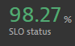
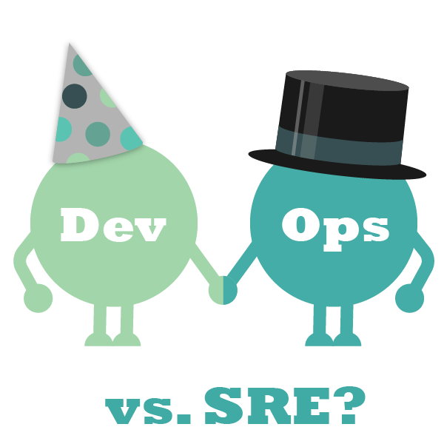
We – SREs and DevOps – need to delivery faster and better!!
DevOps: Automate Speed of Delivery
SRE: Automate Resiliancy of Operations
Deployment Frequency How often an organization successfully releases to production
Lead Time for Changes The amount of time it takes a commit to get into production
Change Failure Rate The percentage of deployments causing a failure in production
Time to Restore Service How long it takes an organization to recover from a failure in production

Slide 5
To get there - DevOps & SREs must automate many tasks through pipelines
Deployment
Blue/Green
Canary
Feature Flagging
Performance Engineering
API Test
Functional Test
Chaos Testing
Configure Monitoring
Quality Gates
Security & Vulnerability Scans
Integrate Approval Process
Chat Notifications
Setup Alerting
SLO Monitoring
SLA Validation
Rollbacks
Auto Remediation

Slide 6
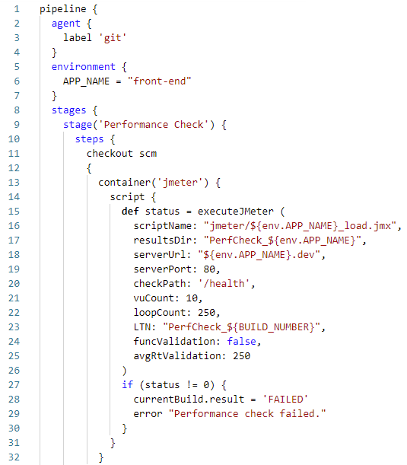
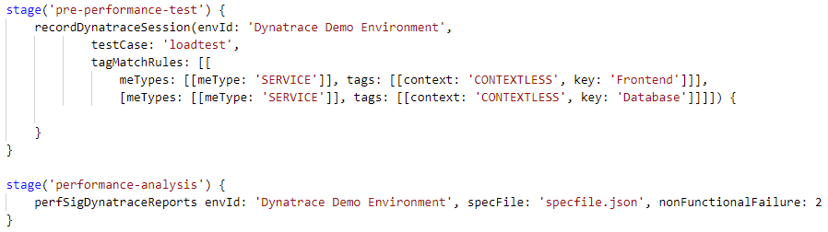
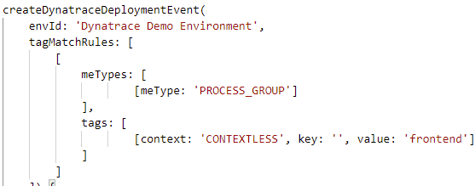
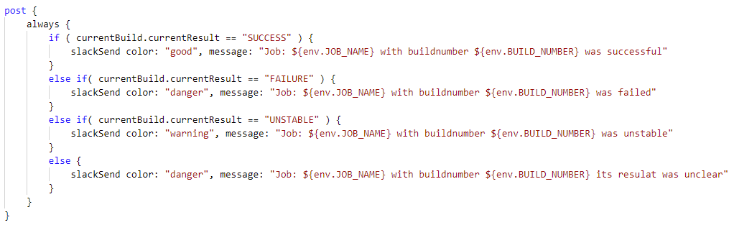
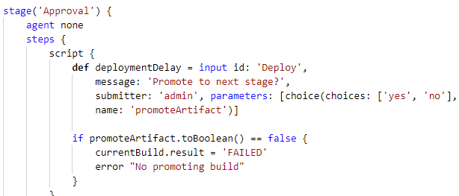
Implementing your own automation in your tool of choice is possible
There clearly is no shortage of „DIY swiss-army knife“ tools to build awesome automation
#1 Execute Test
#2 Add result analysis
#4 Integrate with your APM
#3 Add results notifications to Slack
#5 Add approval process
#6 Add chaos engineering
#7 Add security scan
#8 Add more stages
#9 Add Deployment

Slide 7
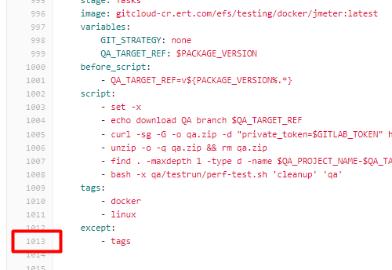



But DIY (Do It Yourself) can become very complex and hard to maintain
„I am constantly reacting to
‚Pipeline Broken – please fix!‘“
Christian Heckelmann Senior DevOps Engineer
2800
projects
966
CI/CDs

Slide 8


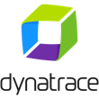
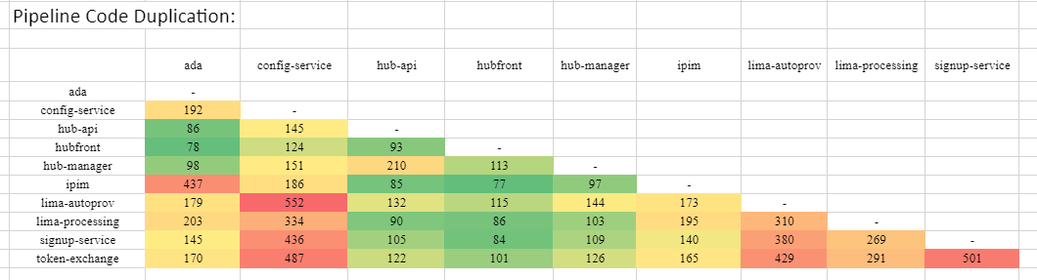
Scaling DIY to many projects often highlights technical debt in your automation
1 Service =
1 Pipeline
1 Project = x Pipelines
n Teams = n*x Pipelines
„Onboarding or updating pipelines is manual & error prone!‘“
pipeline {
stages {
stage('Deploy to dev namespace') {
steps {
container(‘helm’) {
}
}
}
stage('Run tests') {
steps {
container(‘jmeter’) {
}
}
}
stage(‘Evaluate performance’) {
steps {
container(‘curl’) {
}
}
}
if (evaluation.passed) {
stage('Deploy to staging') {
steps {
container(‘helm’) {
}
}
}
}
}
}
pipeline {
stages {
stage('Deploy to dev namespace') {
steps {
container(‘helm’) {
}
}
}
stage('Run tests') {
steps {
container(‘jmeter’) {
}
}
}
stage(‘Evaluate performance’) {
steps {
container(‘curl’) {
}
}
}
if (evaluation.passed) {
stage('Deploy to staging') {
steps {
container(‘helm’) {
}
}
}
}
}
}
pipeline {
stages {
stage('Deploy to dev namespace') {
steps {
container(‘kustomize’) {
}
}
}
stage('Run tests') {
steps {
container(‘jmeter’) {
}
}
}
stage(‘Evaluate performance’) {
steps {
container(‘curl’) {
}
}
}
if (evaluation.passed) {
stage('Deploy to staging') {
steps {
container(‘helm’) {
}
}
}
}
}
}
Dieter Ladenhauf Senior ACE Engineer
25
services
96
workloads

Slide 9
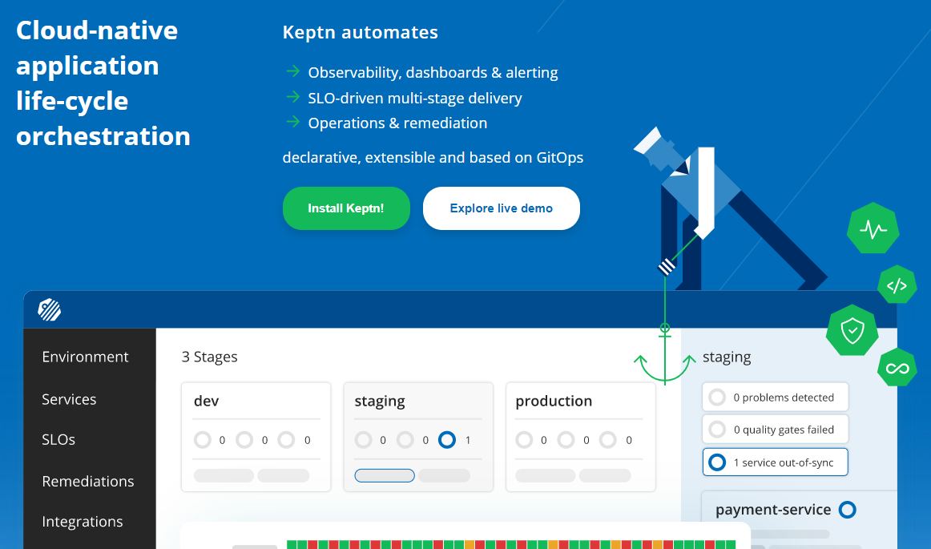
Oh Keptn, my Keptn!

Slide 10



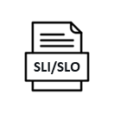

Keptn removes hard-coded dependencies of classical automation approaches
classical-automation-script {
Prepare
Monitoring Tool M1
config
Deploy
Deployment Tool D1
Test
Testing Tool T1
SLO Evaluation
Promote
Notification Tool N1
} // 1000+ lines later

Slide 11
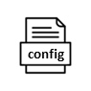

Keptn separates process, tooling and configuration and connects via events
stage: automation-seqeuence
Eventing
Git
Prepare
Monitoring Tool M1
config
Deploy
Deployment Tool D1
Test
Testing Tool T1
SLO Evaluation
Promote
Notification Tool N1

Slide 12
Example #1: automate performance sequence in staging
$ keptn trigger performance --stage=staging --image=myapp:2.0
staging: performance
Eventing
Git
Event:Deploy
Image:myapp:2.0
Stage:staging
Strategy:Blue/Green
Prepare
Monitoring Tool M1
Deploy
Deployment Tool D1
Event:Test
Stage:staging
Strategy:Performance
Test
Testing Tool T1
SLO Evaluation
Event:get-sli
Service:myapp
Stage:staging
Time: last 10min
Notification Tool N1
Promote
Shipyard
Sequence of automation tasks grouped in stages
CloudEvents
Task specific with metadata
Uniform
Subscribed Keptn Services
Config
Tool specific

Slide 13
Example #2: automate canary rollout sequence in production
$ keptn trigger canary-rollout --stage=production --image=myapp:2.0
production: canary-rollout
Eventing
Git
Event:Deploy
Image:myapp:2.0
Stage:production
Strategy:Canary (10%)
Prepare
Monitoring Tool M1
Deploy
Deployment Tool D2
Test
SLO Evaluation
Event:Release
Stage:production
Strategy:Canary (50%)
Notification Tool N2
Release
Shipyard
Sequence of automation tasks grouped in stages
CloudEvents
Task specific with metadata
Uniform
Subscribed Keptn Services
Config
Tool specific

Slide 14
Example #3: remediate production issue
$ keptn trigger remediation --stage=production --problem=high-failurerate --rootcause=log-disk-latency
production: remediation
Eventing
Git
Event:Remedation
Action:clean-disk
Stage:production
Data:/log on nodeB
remediation.yaml (log-disk-latency)
Monitoring Tool M1
Action: clean-disk
Infra Autom. Tool I1
SLO Evaluation
Event:Remediation
Action: rollback
Stage:production
Image:myapp:1.0
Action: rollback
Deployment Tool D2
SLO Evaluation
Notification Tool N2
Event:Escalate
Reason: Failure Rate
Stage:production
Escalate
Ticketing Tool T1
Shipyard
Sequence of automation tasks grouped in stages
CloudEvents
Task specific with metadata
Uniform
Subscribed Keptn Services
Config
Tool specific

Slide 15

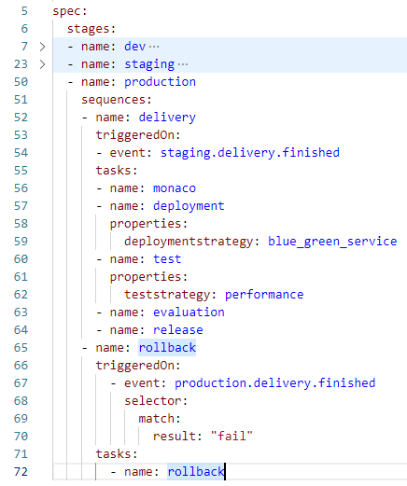












Keptn brings opinionated cloud native automation to all your projects
Reduce your automation‘s complexity by letting
orchestrate declarative, data-driven delivery and ops automation
90% less automation code
Separation of process & tool
GitOps: all config in git
SLOs built-in: drive decisions
Connects with all your tools

Slide 16
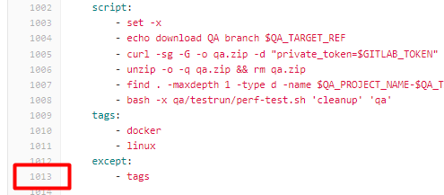
Keptn brings opinionated cloud native automation to all your projects
Reduce your automation‘s complexity by letting
orchestrate declarative, data-driven delivery and ops automation
~ 90% of pipeline code is technical debt
90% less automation code
Process, tool and config are hard coded
Separation of process & tool
GitOps is often an afterthought
GitOps: all config in git
Validation typically happens manually
SLOs built-in: drive decisions
Every new tool is extra work
Connects with all your tools

Slide 17









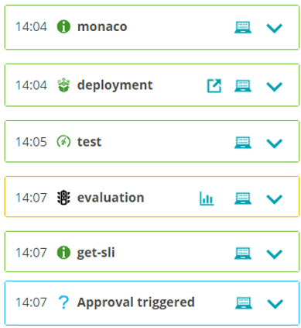
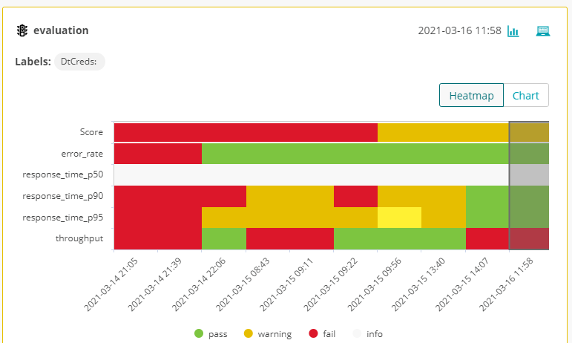


Leverage your existing tooling without writing the automation & integration
triggers an automation sequence
orchestrates monitoring config, deployment, test execution, SLO evaluation & remediation

Slide 18











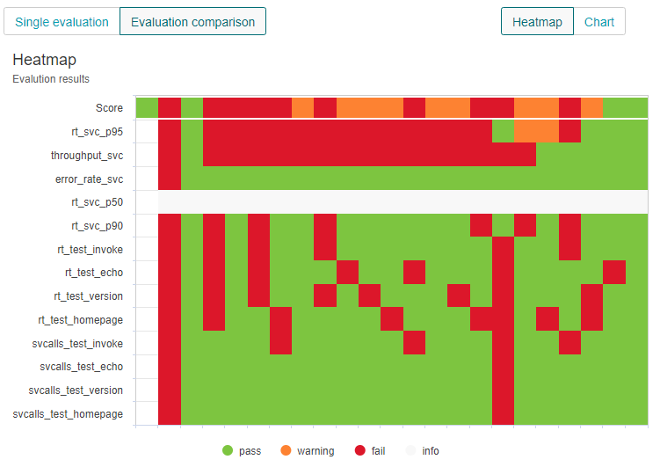
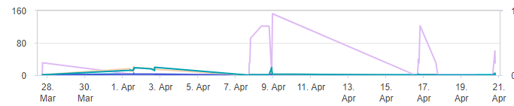
Most Keptn adopters start with integration SLO validation into their pipelines
CD
~30-60min
~1min
V A L I D A T I O N
as
Self-
Svc
Instead of manual test execution and dashboard based analysis
automates test execution and SLO-based evaluation
1
1
2
3
4
x
2
3
4
X
1
2
3
4
x

Slide 19
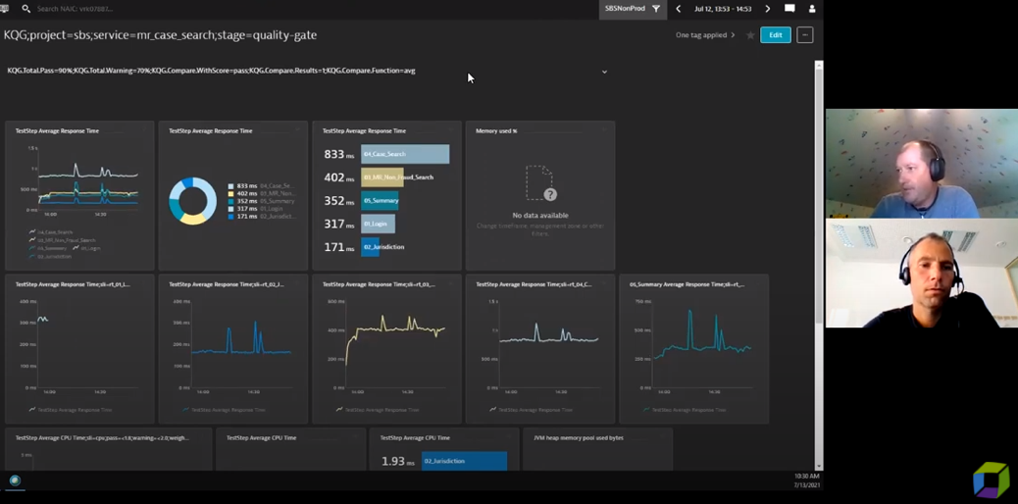
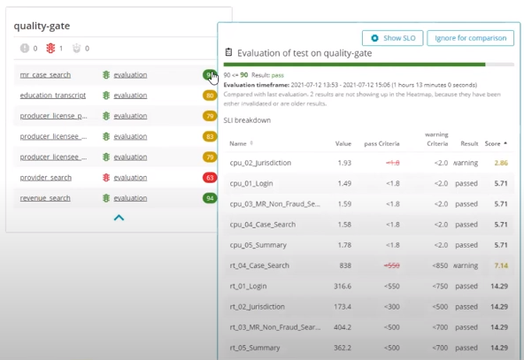
Adoption #1: Automated Performance Test Analysis at NAIC
#1 Mike builds a Dynatrace SLO dashboard
#2 Keptn automates the analysis
https://www.youtube.com/watch?v=6vd8rtcoV9k&list=PLqt2rd0eew1YFx9m8dBFSiGYSBcDuWG38&index=5&t=2s

Slide 20

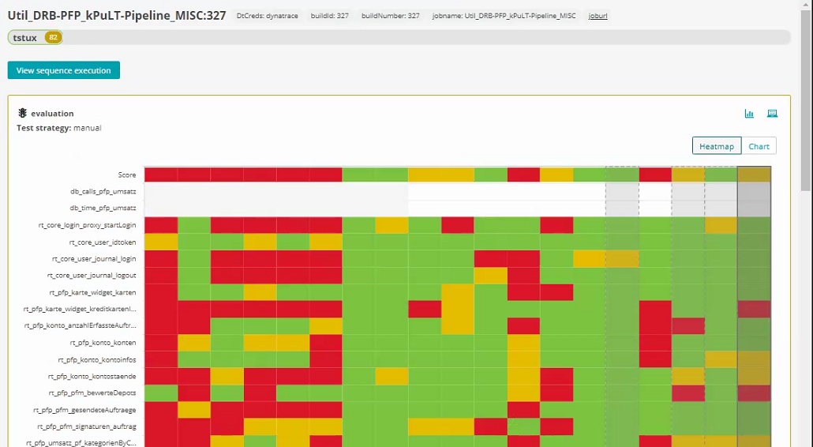
Adoption #2: Automated Release Validation of Austrian Online Banking
#3 Triggered from Jenkins
#2 SLO Score as Quality Gate
#1 Release-relevant SLOs
https://medium.com/keptn/keptn-automates-release-readiness-validation-for-austrian-online-banking-software-eaaab7ad7856

Slide 21

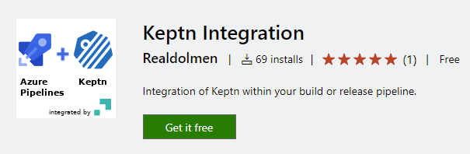

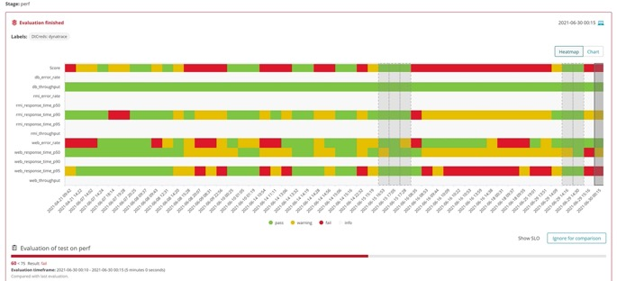
Adoption #3: SLO-driven Azure DevOps Pipelines at Belgium Gov Agency
Keptn Community built Azure DevOps Extension
And increased speed & quality for
Speed up
Delivery
75%
Reduction of
Manual work
80%

Slide 22
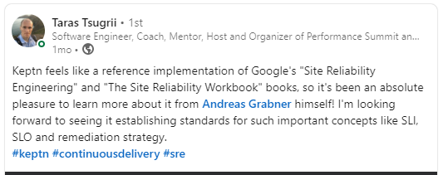
And a great testimonal from a performance engineer at Facebook

Slide 23




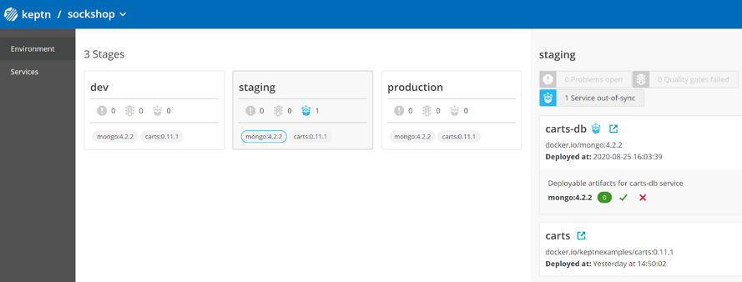


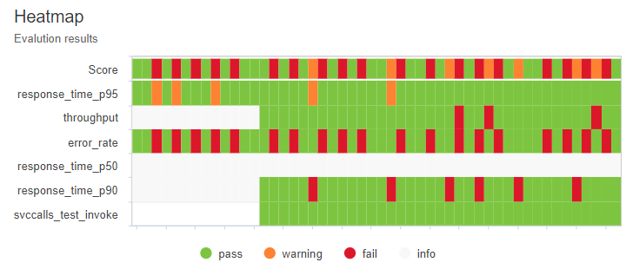















Keptn: GitOps & SLO-Driven Automation for DevOps & SREs
pick your use case
automates configuration and provides self-service for
Monitoring
Delivery
Reliability
Remediation
SLO-Quality
Gates
Progressive
Delivery
SRE
Automation
Auto-
Remediation
bring your configuration
You
(Dev/Ops/SRE)
shipyard
SLI/SLO
workload
runbook
connect your tools
through event-driven process orchestration based on
Declaration
GitOps
SLOs
Standards

Slide 24





Big Thanks to Dynatrace for driving innovation for the DevOps & SRE community
Speed
Quality
Collaboration
Scale
Increase Speed of App Delivery by 75%
Improve Confidence
with 50% Better Release Quality
100% Better Collaboration between Dev & Ops
Scale DevOps Enterprise-wide
Eliminate toil through automation (monitoring, test evaluation, remediation)
Increase quality and resiliency with Shift-left, Shift-right
One platform, single source of truth, common language of SLOs
Self-service models, Automation, AI-driven decision making

Slide 25
GitOps & SLO-Driven Automation driving faster and better releases!
Andreas Grabner
DevOps Activist at Dynatrace
DevRel for Keptn
@grabnerandi, https://www.linkedin.com/in/grabnerandi
Follow us @keptnProject
Star us @ https://github.com/keptn/keptn
Slack Us @ https://slack.keptn.sh

